Slide 1
BCSE204L Design and Analysis of Algorithms
Overview of the course
Dr Athira K
SCOPE

Slide 2
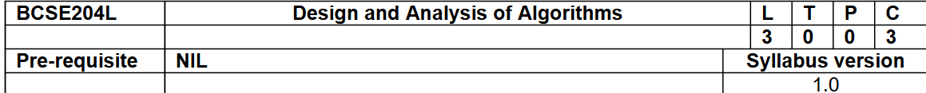
About the course
Course Objectives:
To provide mathematical foundations for analyzing the complexity of the algorithms
To impart the knowledge on various design strategies that can help in solving the real world problems effectively
To synthesize efficient algorithms in various engineering design situations

Slide 3
Course Outcomes
Apply the mathematical tools to analyze and derive the running time of the algorithms
Demonstrate the major algorithm design paradigms.
Explain major graph algorithms, string matching and geometric algorithms along with their analysis.
Articulating Randomized Algorithms.
Explain the hardness of real-world problems with respect to algorithmic efficiency and learning to cope with it.

Slide 4
Module:1 Design Paradigms: Greedy, Divide and Conquer Techniques
Introduction
Time complexity
Proof of correctness
Greedy techniques
Fractional Knapsack Problem
Huffman coding
Divide and Conquer
Maximum Subarray
Karatsuba faster integer multiplication algorithm

Slide 5
Module:2 Design Paradigms: Dynamic Programming, Backtracking and Branch & Bound Technique
Dynamic programming:
Assembly Line Scheduling
Matrix Chain Multiplication
Longest Common Subsequence
0-1 Knapsack
TSP

Slide 6
Module 2 [cont..]
Backtracking
N-Queens problem
Subset Sum
Graph Coloring
Branch & Bound
Job Selection problem
0-1 Knapsack Problem

Slide 7
Module:3 String Matching Algorithms
Naïve String-matching Algorithm
KMP algorithm
Rabin-Karp Algorithm
Suffix Trees

Slide 8
Module:4 Graph Algorithms
All pair shortest path:
Bellman Ford Algorithm
Floyd-Warshall Algorithm
Network Flows:
Maximum Flows
Ford-Fulkerson
Edmond-Karp
Push Re-label Algorithm
Application of Max Flow to maximum matching problem

Slide 9
Module:5 Geometric Algorithms
Line Segments
Properties, Intersection, sweeping lines
Convex Hull finding algorithms
Graham’s Scan
Jarvis’ March Algorithm

Slide 10
Module:6 Randomized algorithms
Randomized quick sort
The hiring problem
Finding the global Minimum Cut

Slide 11
Module:7 Classes of Complexity and Approximation Algorithms
The Class P
The Class NP
Reducibility and NP-completeness
SAT (Problem Definition and statement)
3SAT
Independent Set
Clique

Slide 12
Module:7 Classes of Complexity and Approximation Algorithms [cont..]
Approximation Algorithms
Vertex Cover
Set Cover
Travelling salesman problem

Slide 13
Module:8 Contemporary Issues
Will be decided later

Slide 14
Study Materials
Text books
Thomas H. Cormen, C.E. Leiserson, R L.Rivest and C. Stein, Introduction to Algorithms , Third edition, MIT Press, 2009.
Reference books
Jon Kleinberg, ÉvaTardos ,Algorithm Design, Pearson education, 2014
Ravindra K. Ahuja, Thomas L. Magnanti, and James B. Orlin, “Network Flows: Theory, Algorithms, and Applications”, Pearson Education, 2014
Rajeev Motwani, Prabhakar Raghavan; Randomized Algorithms, Cambridge University Press, 1995 (Online Print – 2013)

Slide 15
Assessment Methodologies and Rubrics
Assessment type | Due Date | Max Marks | Weightage | Remarks
Quiz-1 | Before CAT1 | 10 | 10 | 80% of the marks, if re-quiz
CAT-1 | 11-02-24 to 17-02-24 | 50 | 15
Quiz-2 | Between CAT-1 and CAT-2 | 10 | 10 | 80% of the marks, if re-quiz
DA | Submission after CAT-2 | 10 | 10 | Rubrics is given separately
CAT-2 | 01-04-24 to 07-04-24 | 50 | 15
FAT | After 06-05-24 | 100 | 40

Slide 16
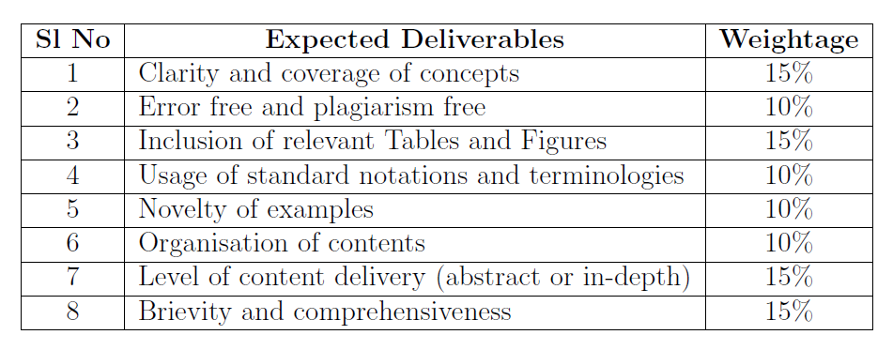
DA Rubrics

Slide 17
General Guidelines
All queries will be addressed physically or through WhatsApp texting , feel free to ask (Advantage: I can easily recognize you)
Need a single point of contact
All DAs must be submitted through VTOP and/or Moodle only. No other mode (such as email) is accepted
Submit assignments well in advance to avoid probable network issues/VTOP login errors at the last moment which leads t asking for excuses

Slide 18
Moodle Account
Hope it is ready for everyone.

Slide 19
Queries
?

Slide 20
Thank you..!!

